Slide 1
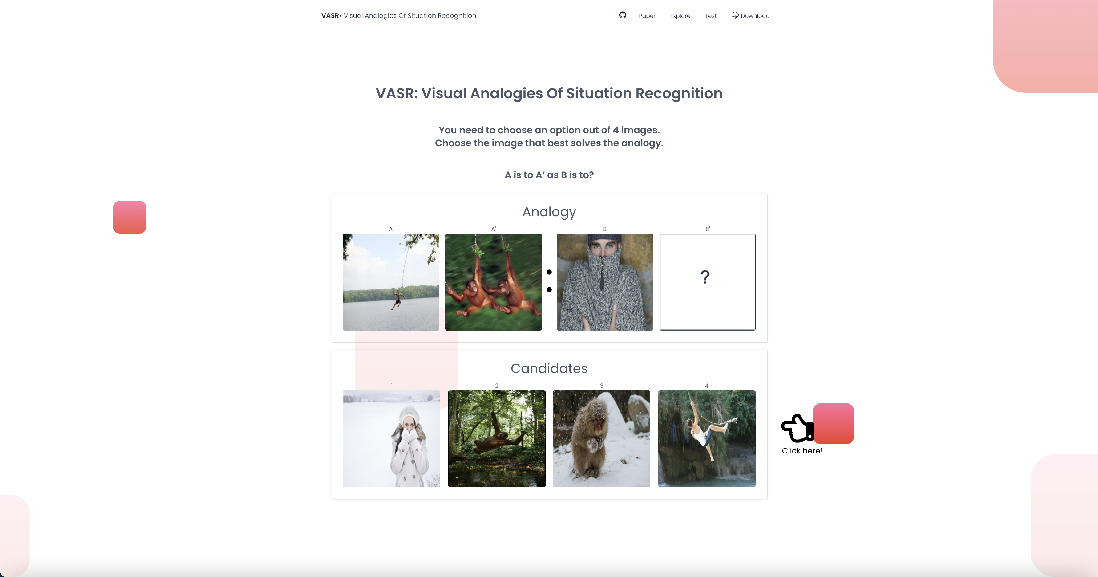

VLAB $∙$ Vision and Language Association Benchmark
BEAT THE AI
VLAB allows two tasks of interactive games
BEAT THE AI
Give The Cue
Guess The Associations
Five images are presented below.
Choose several images and enter a cue word.
The AI will try to guess which of the images associate with your cue.
Five images are presented below.
A cue word and a number are given:
$(Cue, \#Associations)$
Choose$\#Associations$ images that associate with the $Cue$ word.
Let's Play
Let's Play

Slide 2

VLAB $∙$ Vision and Language Association Benchmark
BEAT THE AI
VLAB allows two tasks of interactive games
BEAT THE AI
Give The Cue
Guess The Associations
Five images are presented below.
Choose several images and enter a cue word.
The AI will try to guess which of the images associate with your cue.
Five images are presented below.
A cue word and a number are given:
$(Cue, \#Associations)$
Choose$\#Associations$ images that associate with the $Cue$ word.
Let's Play
Let's Play
Got It!
Let’s play the combined game!
Let's Play

Slide 3


VLAB $∙$ Vision and Language Association Benchmark
BEAT THE AI
VLAB: Vision and Language Association Benchmark
BEAT THE AI – GIVE THE CUE
Five images are presented below.
Choose several images and enter a cue word.
The AI will try to guess which of the images associate with your cue.
Cue
Tarzan
Enter here!
Choose here!
TEST AI
Choose other candidates

Slide 4





VLAB $∙$ Vision and Language Association Benchmark
BEAT THE AI
VLAB: Vision and Language Association Benchmark
BEAT THE AI – GIVE THE CUE
Five images are presented below.
Choose several images and enter a cue word that describes them best.
The AI will try to guess the which images descibes your cue
$$Cue \#Associations$$
Tarzan
2
AI Response
MY TOTAL SCORE
MY CURRENT SCORE
AI TOTAL SCORE
AI CURRENT SCORE
AI TOTAL SCORE
75%
66%
25%
33%
25%
Another round please!

Slide 5
VLAB $∙$ Vision and Language Association Benchmark
BEAT THE AI
VLAB: Vision and Language Association Benchmark
BEAT THE AI – GIVE THE CUE
Five images are presented below.
Choose several images and enter a cue word that describes them best.
The AI will try to guess the which images descibes your cue
$$Cue \#Associations$$
Tarzan
2
AI Response
How is my score calculated?
Proportion of the associations that the AI didn’t guess correctly.
MY TOTAL SCORE
MY CURRENT SCORE
AI TOTAL SCORE
AI CURRENT SCORE
AI TOTAL SCORE
75%
66%
25%
33%
25%
Another round please!

Slide 6
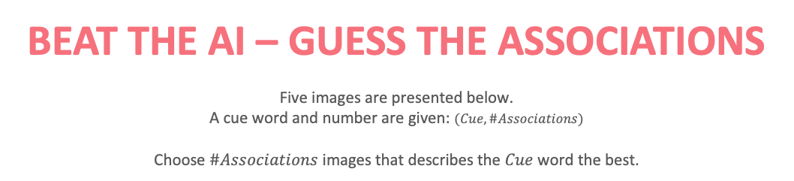
VLAB $∙$ Vision and Language Association Benchmark
BEAT THE AI
VLAB: Vision and Language Association Benchmark
BEAT THE AI – GUESS THE ASSOCIATIONS
Five images are presented below.
A cue word and number are given: $(Cue, \#Associations)$
Choose $\#Associations$ images that describes the $Cue$ word the best.
BEAT THE AI
Five images are presented below.
Choose several images and enter a cue word that describes them best.
The AI will try to guess the which images descibes your cue
$$Cue \#Associations$$
Shivering
3
Choose here!
TEST ME
Choose other candidates

Slide 7
VLAB $∙$ Vision and Language Association Benchmark
BEAT THE AI
VLAB: Vision and Language Association Benchmark
BEAT THE AI – GUESS THE ASSOCIATIONS
Five images are presented below.
Choose several images and enter a cue word that describes them best.
The AI will try to guess the which images descibes your cue
$$Cue Num_{Assoc}$$
Shivering
3
AI Response
MY TOTAL SCORE
MY CURRENT SCORE
AI TOTAL SCORE
75%
100%
25%
Another round please!

Slide 8
VLAB $∙$ Vision and Language Association Benchmark
BEAT THE AI
VLAB: Vision and Language Association Benchmark
BEAT THE AI – GUESS THE ASSOCIATIONS
Five images are presented below.
Choose several images and enter a cue word that describes them best.
The AI will try to guess the which images descibes your cue
$$Cue Num_{Assoc}$$
Shivering
3
AI Response
How is my score calculated?
Proportion of the associations that you guess correctly.
MY TOTAL SCORE
MY CURRENT SCORE
AI TOTAL SCORE
75%
100%
25%
Another round please!

